Slide 1
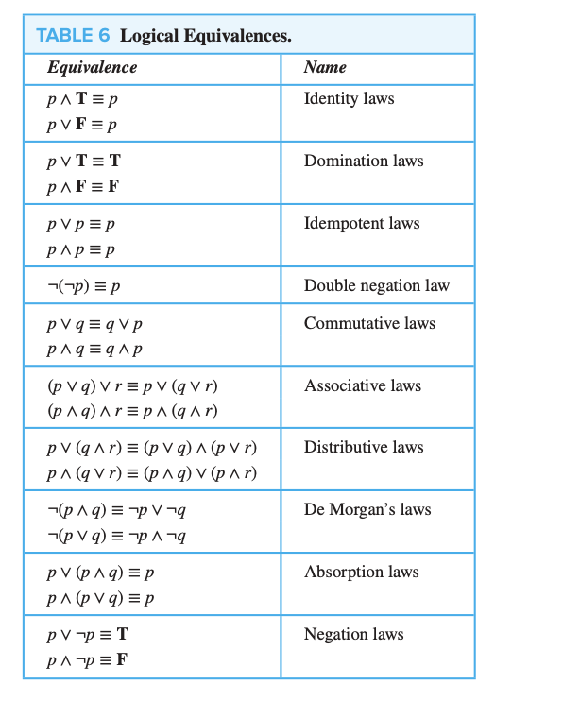

Slide 2
Logical Inferences:
A set of premises accompanied by a suggested conclusion regardless of whether or not the conclusion is a logical consequence of the premises.
Hence it may be valid inference or faulty inference.
Inference is written as
(conjunction of premises) → (conclusion)
Inference is valid if the implication is tautology otherwise invalid or faulty inference or fallacy
Tautology
Not a Tautology
valid inference
invalid inference (faulty)

Slide 3
Rules of Inference – valid: There are 4 fundamental rules
Fundamental rule 1: If the statement in P is assumed as True, and the statement P →Q is accepted as true, then we must accept Q as True. (Modus Ponens Rule)
Symbolically P
P →Q
therefore Q
Fundamental rule 2: Whenever two implications P →Q and
Q →R are accepted as true then we must accept the implication
P →R as true (Hypothetical Syllogism or Transitive Rule)
Symbolically P →Q
Q →R
therefore P → R
Hypothesis / premises
Conclusion
Hypothesis / premises
Conclusion

Slide 4
Fundamental rule 3: DeMorgan’s Law
~( P V Q ) = ~P ^ ~Q
~( P ^ Q ) = ~P V ~Q
Fundamental rule 4: Law of Contra positive
P → Q = ~ Q → ~ P

Slide 5
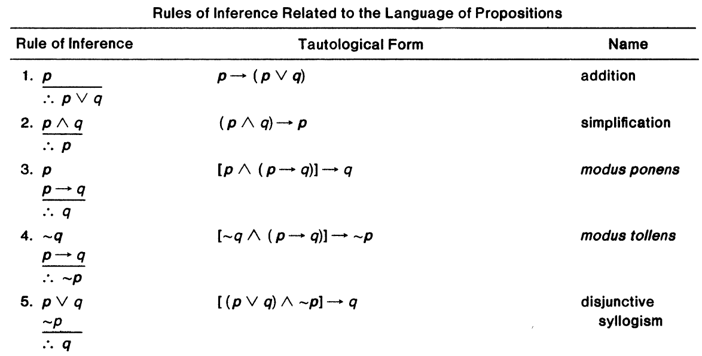

Slide 6
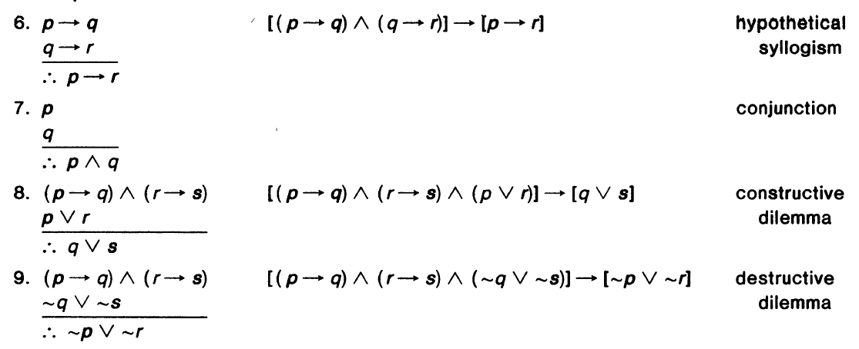

Slide 7
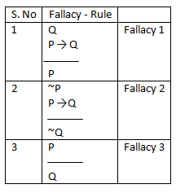
Rules of Inference – Invalid
Logical inference is invalid if the implication is not a tautology
Also called as faulty inference or fallacy
Inference is written as
(conjunction of premises) → (conclusion)
Tautology
Not a Tautology
valid
inference
Invalid
inference (faulty)

Slide 8
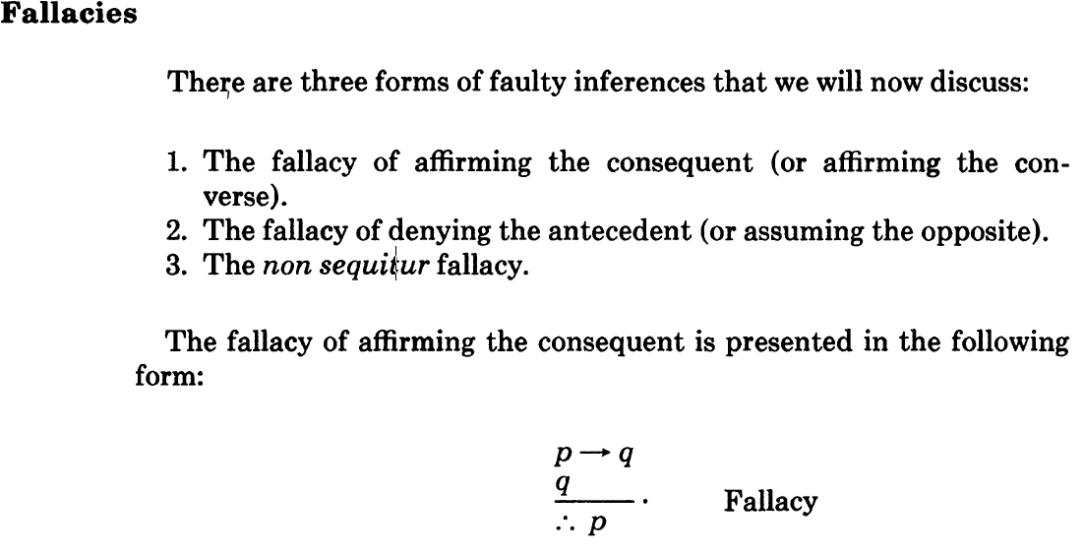
Rule 1 (Fallacy 1)

Slide 9
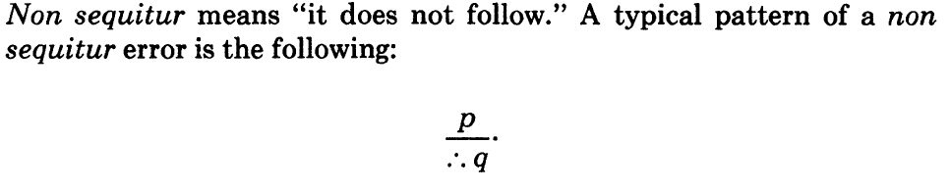
The fallacy of denying the antecedent takes the form
P →Q
~P
therefore ~Q
Rule 2 (Fallacy 2)
Rule 3 (Fallacy 3)

Slide 10
Exercise Problems:
Determine the following arguments are valid or invalid
p → q 2. r → s 3. r → s
q → r ~s p → q
r → s −−−−−− r V p
−−−−−− ~r −−−−−−
p → s s V q

Slide 11
Determine the following arguments are valid or invalid
4. p → (r → s) 5. ~ r→(s → ~t) 6. p
~r → ~p ~r V w p → q
p ~p → s q → r
−−−−−−− ~w −−−−−−−
s −−−−−−− r
t → p

Slide 12
Determine the following arguments are valid or invalid
7. ~p 8. (p Ʌ q) → ~t
p → q w V r
q → r w → p
−−−−−−− r → q
~r −−−−−−−−−−−−
(w V r) → ~t

Slide 13
Determine the following arguments are valid or invalid
9.
If Tallahassee is not in Florida, then golf balls are not sold in Chicago.
Golf balls are not sold in Chicago.
Hence, Tallahassee is in Florida.
10.
If a baby is hungry, then the baby cries.
If the baby is not mad, then he does not cry.
If a baby is mad, then he has a red face.
Therefore, if a baby is hungry, then he has a red face.

Slide 14
Determine the following arguments are valid or invalid
11.
If Nixon is not reelected, then Tulsa will lose it air base.
Nixon will be re-elected iff Tulsa will vote for him.
If Tulsa keeps its air base, Nixon will be re-elected.
Therefore, Nixon will be reelected.

Slide 15
Fill the blanks
12.
If today is Thursday, 10days from now will be Monday.
Today is Thursday.
Hence,________________
13.
If today is Sunday, then I will go to church.
______________________
Therefore, I will go to church.

Slide 16
Fill in the blanks for conformity with transitive rule.
14. Triangle ABC is equilateral implies triangle ABC is equiangular.
Triangle ABC is equiangular implies angle A=60.
Hence, _______________________

Slide 17
Determine whether the argument is valid or invalid
15. If today is David’s Birthday, then today is January 24th.
Today is January 24th.
Hence, today is David’s Birthday

Slide 18
Use a contradiction argument to verify the following valid inferences.
16. q → t 17. ~p → (q →~w)
s → r ~s → q
q V s ~t
________ ~p V t
t V r _______
w → s

Slide 19
Use contrapositive argument to verify the following valid inference
18. w → (r →s)
____________
(w Ʌ r) → s

